Slide 1
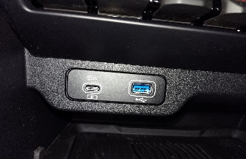
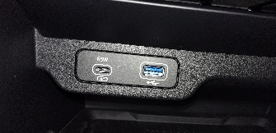
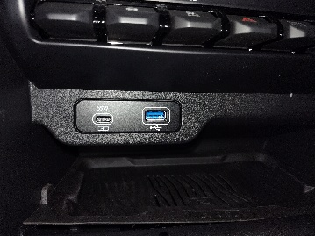
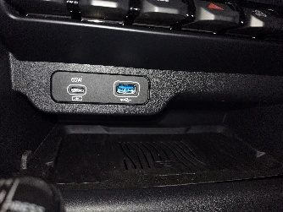
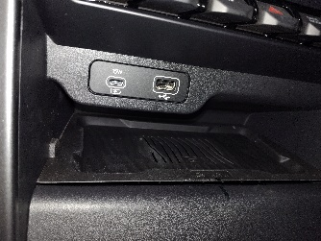
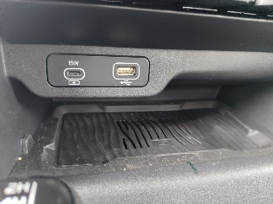
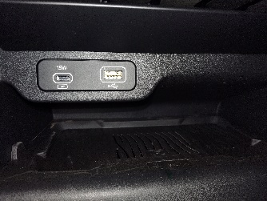
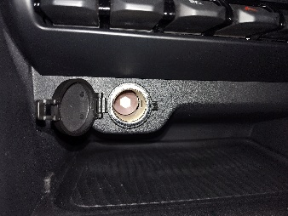
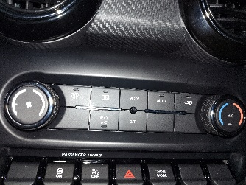
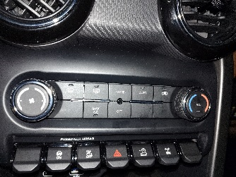
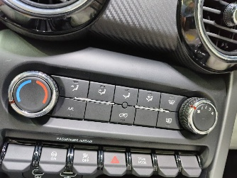
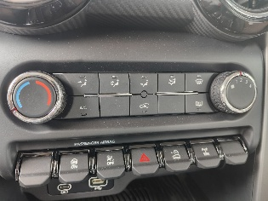
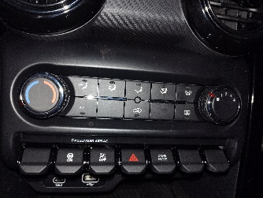
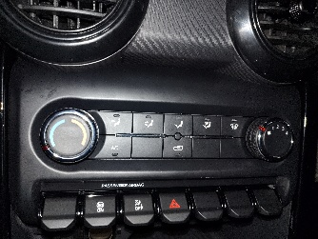
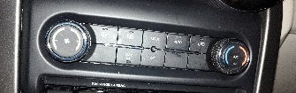
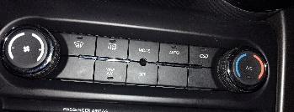
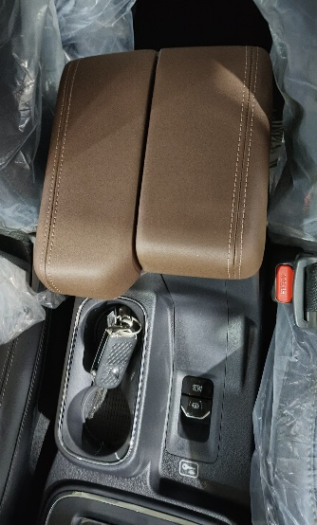
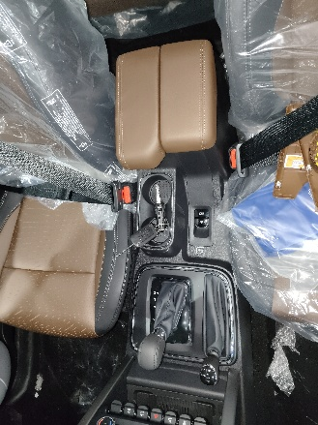
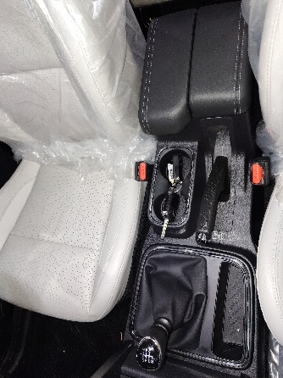
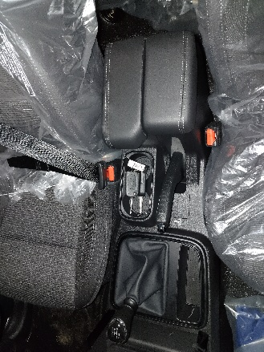
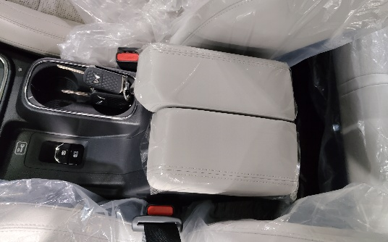
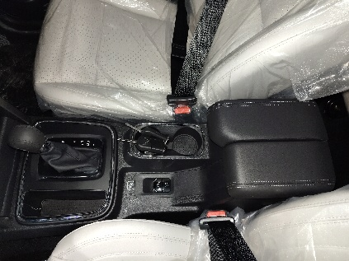
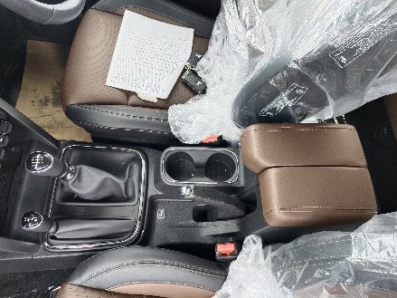
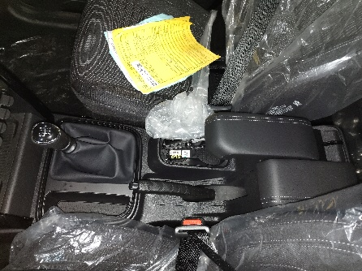
Variant Matrix
Sr.No | Part Name | AX7L |  | AX5L |  | MX5 |  | AX3L | MX3 | MX1
 |  | Grey | Mocha | Grey | Mocha | Grey | Mocha
1 | Wireless Charger
2 | AC Controller
3 | Floor Console Assy. F
65W + Blue ring USB
15W + white ring USB
12V
Manual AC button
No defogger
Different Colour Arm rest

Slide 2
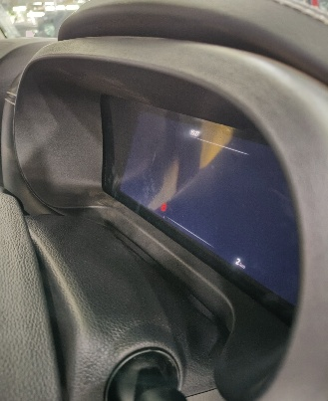
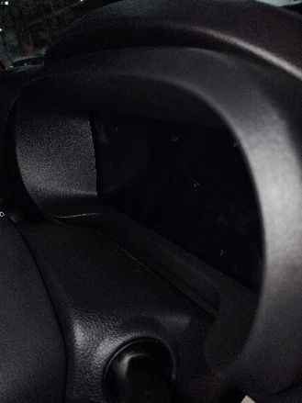
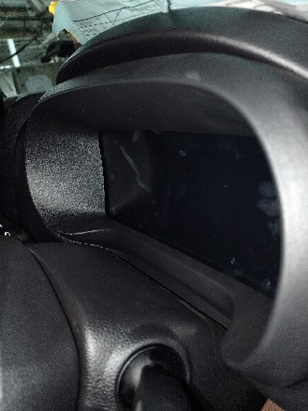
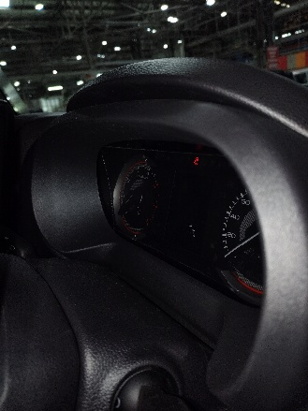
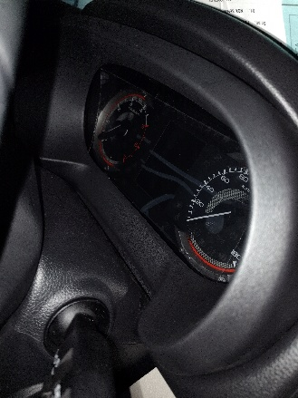
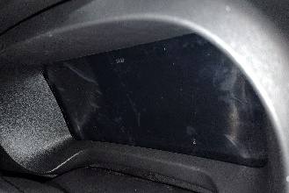
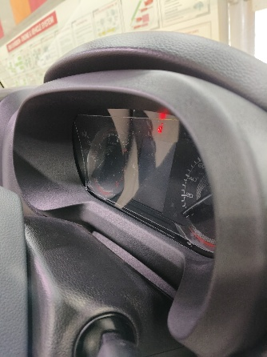
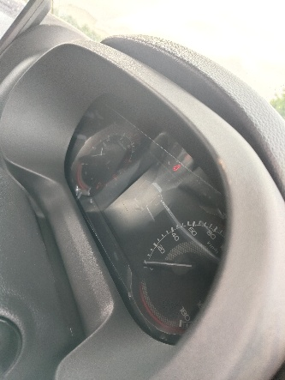
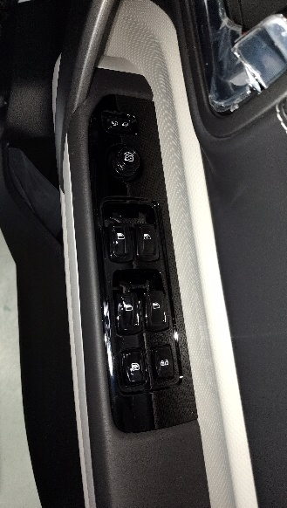
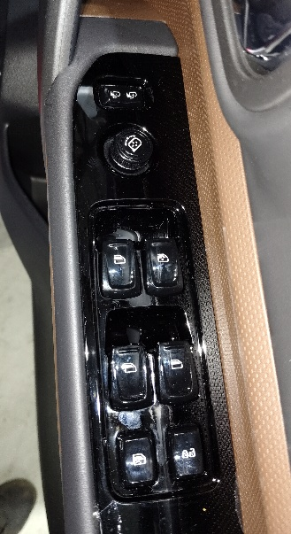
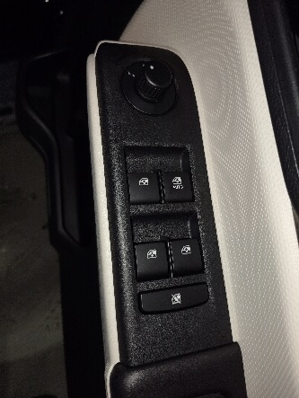
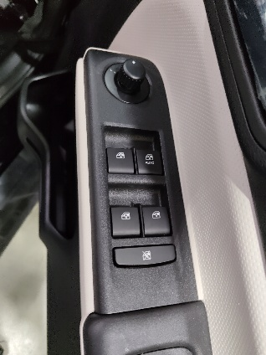
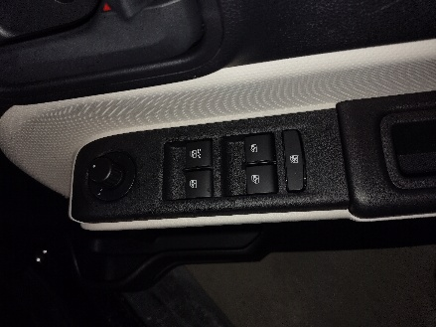
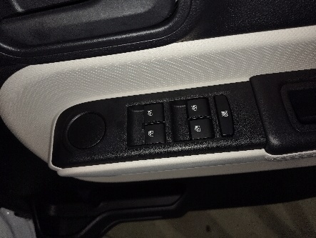
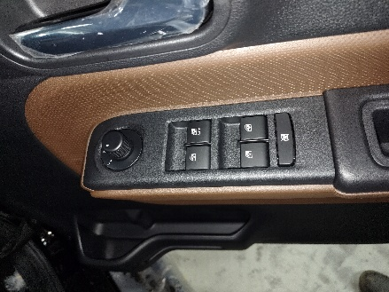
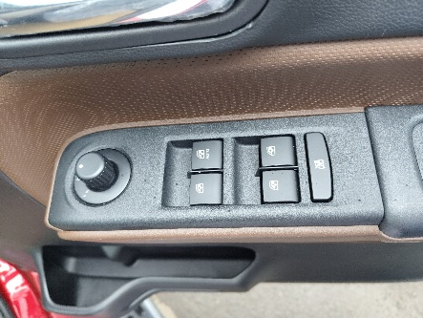
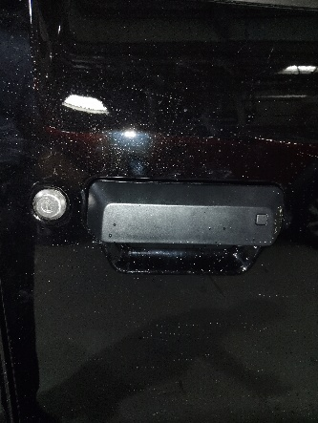
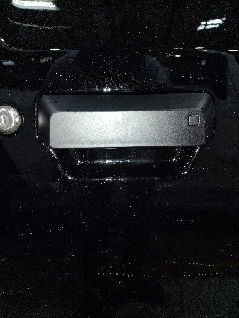
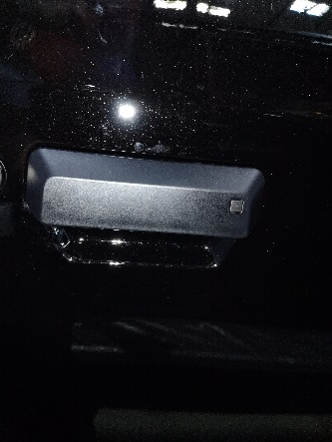
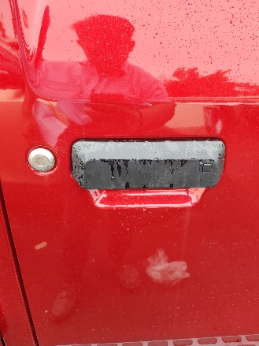
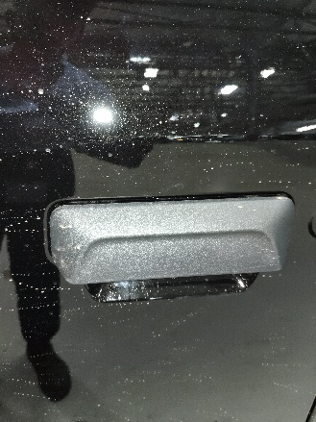
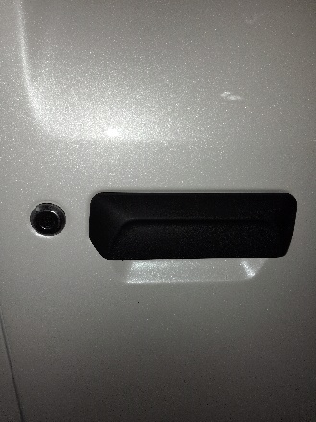
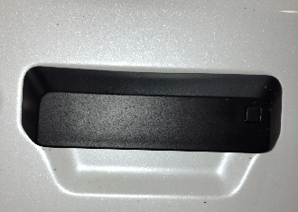
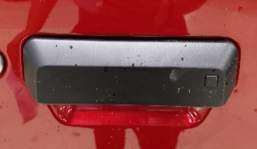
Variant Matrix
Sr.No | Part Name | AX7L |  | AX5L |  | MX5 |  | AX3L | MX3 | MX1
 |  | Grey | Mocha | Grey | Mocha | Grey | Mocha
4 | Cluster Bezel
5 | Power Window Switch
6 | Front Door Outer Handle RH with Switch
Photos will resubmit
Rectangular edge
Rectangular edge
Circular edge
Circular edge
Glossy Panel
matt Panel
No ORVM Switch
PKE Switch
No switch

Slide 3
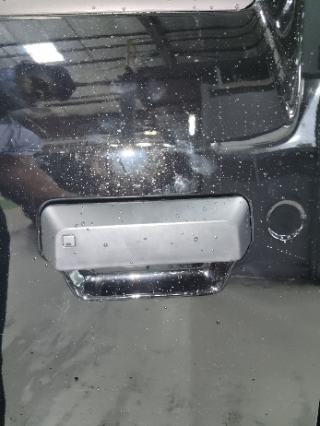
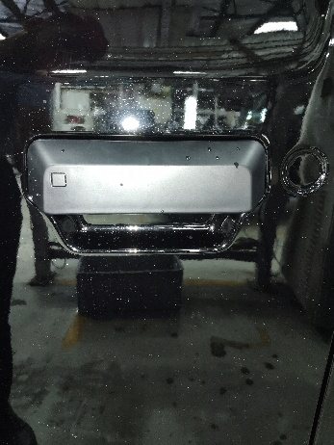






















Variant Matrix
Sr.No | Part Name | AX7L |  | AX5L |  | MX5 |  | AX3L | MX3 | MX1
 |  | Grey | Mocha | Grey | Mocha | Grey | Mocha
7 | Front Door Outer Handle LH with Switch
8 | Front Windshield Glass
9 | IRVM
PKE Switch –same like point 6
No switch
1
Photos will resubmit
ADAS Cover
RTLS Cover
No cover
Bezel less IRVM
Normal IRVM

Slide 4
























Variant Matrix
Sr.No | Part Name | AX7L |  | AX5L |  | MX5 |  | AX3L | MX3 | MX1
 |  | Grey | Mocha | Grey | Mocha | Grey | Mocha
10 | Sunvisor Hook
11 | Brand Plate
12 | Hand Brake
Hidden Screw
Visible Screw
Different Colour of trims
Electronic Parking Brake
Conventional Parking Brake
Convenctional Parking Brake

Slide 5
























Variant Matrix
Sr.No | Part Name | AX7L |  | AX5L |  | MX5 |  | AX3L | MX3 | MX1
 |  | Grey | Mocha | Grey | Mocha | Grey | Mocha
13 | Seat Head Rest
14 | Rear Header Trim
15 | Axl Door Inner Handle
5
Different Colour of trims
Wire Visible
No wire
4
Chrome colour
Black colour

Slide 6
























Variant Matrix
Sr.No | Part Name | AX7L |  | AX5L |  | MX5 |  | AX3L | MX3 | MX1
 |  | Grey | Mocha | Grey | Mocha | Grey | Mocha
16 | Spare Wheel
17 | IP Switch Panel
18 | Tail Gate Glass
No cover + Alloy
Wheel cover
No cover + steel
Variant code wise more combination in switches
Orange lines
No lines

Slide 7
























Variant Matrix
Sr.No | Part Name | AX7L |  | AX5L |  | MX5 |  | AX3L | MX3 | MX1
 |  | Grey | Mocha | Grey | Mocha | Grey | Mocha
19 | Tail gate inner handle
20 | Piano Switch
21 | AC Vent
3
Photos will resubmit
Variant code wise more combination in switches
Chrome ring
Black ring

Slide 8
























Variant Matrix
Sr.No | Part Name | AX7L |  | AX5L |  | MX5 |  | AX3L | MX3 | MX1
 |  | Grey | Mocha | Grey | Mocha | Grey | Mocha
22 | Information Display
23 | Floor Console Mat
24 | Trim Pad RH Front
Big display
Small display
Wireless charger mat
Normal Mat
2
Different Colour of trims

Slide 9
























Variant Matrix
Sr.No | Part Name | AX7L |  | AX5L |  | MX5 |  | AX3L | MX3 | MX1
 |  | Grey | Mocha | Grey | Mocha | Grey | Mocha
25 | Trim Pad RH Rear
26 | Trim Pad LH Front
27 | Trim Pad LH Rear
2
Different Colour of trims
2
Different Colour of trims
2
Different Colour of trims

